Slide 1
Implementation of distributed ML

Slide 2
Lock and lock-free
Partition data and sampling data
Share memory and parameter server
Under parameter server
Decentralize architecture

Slide 3
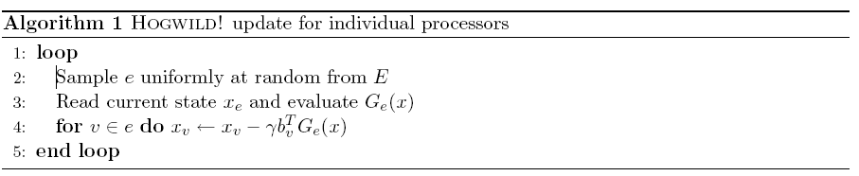
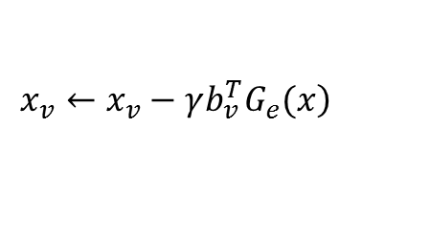
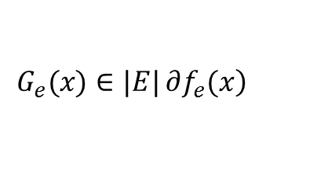
Lock and lock-free
$$\left.G_{e}(x)∈|E|∂f_{e}(x\right)$$
$$\left.x_{v}←x_{v}−γb_{v}^{T}G_{e}(x\right)$$
Assume
only a single coordinate per sampled hyperedge is updated (i.e.,the for loop in Hogwild! is replaced with a single coordinate update);
the authors assumed consistent reads, i.e., it was assumed that while a core is reading the shared variable, no writes from other cores occur;
the authors make an implicit assumption on the uniformity of the processing times of cores (explained in the following), that does not generically hold in practice

Slide 4

Lock and lock-free
Consistent read
Inconsistent read
两篇文章
Argue 他们的 至少3篇

Slide 5
Partition data and sampling data

Slide 6
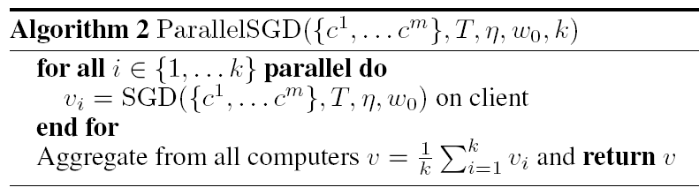
MapReduce framework

Slide 7
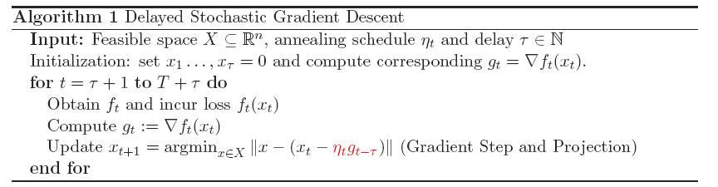
Lock
read / write-locking mechanism for x ,atomic updates on the parameter vector

Slide 8

$$p_{v}=b_{v}b_{v}^{T} G_{e}\left(x\right)=$$
Assume
only a single coordinate per sampled hyperedge is updated (i.e.,the for loop in Hogwild! is replaced with a single coordinate update);
the authors assumed consistent reads, i.e., it was assumed that while a core is reading the shared variable, no writes from other cores occur;
the authors make an implicit assumption on the uniformity of the processing times of cores (explained in the following), that does not generically hold in practice

Slide 9
original

Slide 10
downpour

Slide 11
ssp

Slide 12
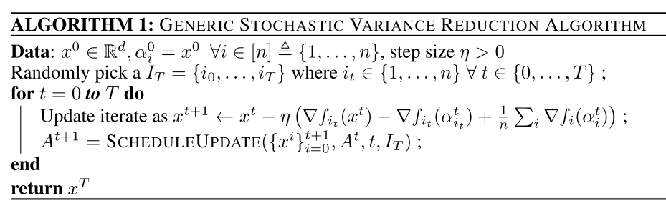
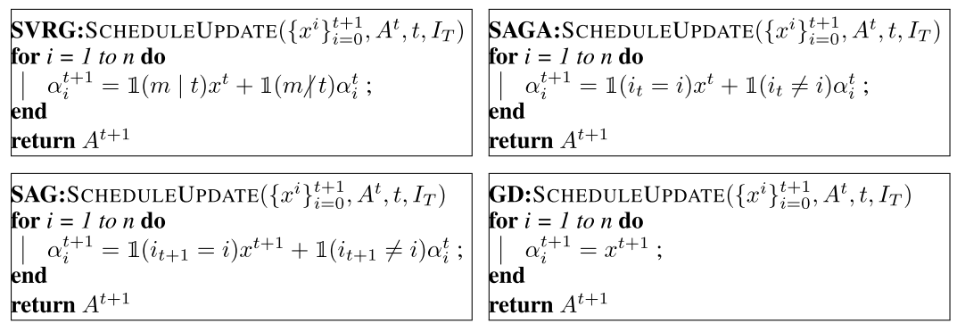

Slide 13
